Slide 1
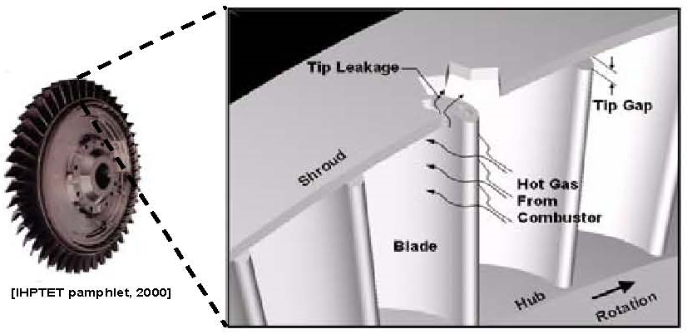
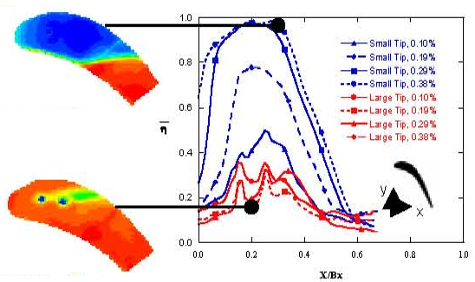
TÜBİTAK 1601 OMÜGEM 2.GİRİŞİMCİLİK PROJE PAZARI
10 MAYIS 2017 , SAMSUN TEKNOPARK
Poster Başlığı , Calibri, 96 points, Bold
Yazar adı, fakültesi, bölümü Calibri, 60 Points, Bold
ÖZET, Calibri, 54 points, bold
Text in Calibri, 40 points, Bold. Text in Calibri, 40 points, Bold. Text in Calibri, 40 points, Bold. Text in Calibri, 40 points, Bold. Text in Calibri, 40 points, Bold. Text in Calibri, 40 points, Bold. Text in Calibri, 40 points, Bold. Text in Calibri, 40 points, Bold. Text in Calibri, 40 points, Bold. Text in Calibri, 40 points, Bold.
Anahtar Kelimeler: Caption in Calibri, 36 points, bold.
YÖNTEM/MATERYAL ve METOT, Calibri, 54 points, bold
Text in Calibri, 40 points, Bold. Text in Calibri, 40 points, Bold. Text in Calibri, 40 points, Bold.. Text in Calibri, 40 points, Bold. Text in Calibri, 40 points, Bold. Text in Calibri, 40 points, Bold.. Text in Calibri, 40 points, Bold. Text in Calibri, 40 points, Bold. Text in Calibri, 40 points, Bold..
AMAÇ/ÖZGÜN DEĞER, Calibri, 54 points, bold
Text in Calibri, 40 points, Bold. Text in Calibri, 40 points, Bold. Text in Calibri, 40 points, Bold. Text in Calibri, 40 points, Bold. Text in Calibri, 40 points, Bold. Text in Calibri, 40 points, Bold. Text in Calibri, 40 points, Bold. Text in Calibri, 40 points, Bold. Text in Calibri, 40 points, B
Resim 2. Yazı stili calibri, yazı boyu 38 ve resim 300 dpi kalitesinde olacaktır.
SONUÇ, Calibri, 54 points, bold
Text in Calibri, 40 points, Bold. Text in Calibri, 40 points, Bold. Text in Calibri, 40 points, Bold. Text in Calibri, 40 points, Bold. Text in Calibri, 40 points, Bold. Text in Calibri, 40 points, Bold. Text in Calibri, 40 points, Bold. Text in Calibri, 40 points, Bold.
Resim 1. Yazı stili calibri, yazı boyu 38 ve resim 300 dpi kalitesinde olacaktır.
YÖNTEM/MATERYAL ve METOT, Calibri, 54 points, bold
Text in Calibri, 40 points, Bold. Text in Calibri, 40 points, Bold. Text in Calibri, 40 points, Bold..
Resim 3. Yazı stili calibri, yazı boyu 38 ve resim 300 dpi kalitesinde olacaktır.
.
REFERANSLAR, Calibri, 54 points, bold
Text in Calibri, 40 points, Bold. Text in Calibri, 40 points, Bold. Text in Calibri, 40 points, Bold.

